Slide 1
Defensive Security Project

Slide 2
Table of Contents
This document contains the following resources:
Monitoring Environment
Attack Analysis
Project Summary & Future Mitigations

Slide 3

Monitoring Environment
3

Slide 4
Scenario
Client
Virtual Space Industries (VSI)
Domain
Virtual-reality development
Security Analysis
VSI recently experienced several cyberattacks, likely from their adversary JobeCorp.
Splunk will be used to analyze data.
The VSI products that were targete include:
An administrative webpage: https://vsi-corporation.azurewebsites.net/
An Apache web server, which hosts this webpage
A Windows operating system, which runs many of VSI’s back-end operations
VSI’s networking team has provided past logs as well as attack logs.
Data
Windows Server Logs
Windows Server Attack Logs
Apache Server Logs
Apache Server Attack Logs
Tools
Splunk
Splunk Security Essentials Add-on

Slide 5
Splunk Security Essentials App
5

Slide 6
Splunk Security Essentials (SSE)
SSE explores security use cases and discover security content to address threats and challenges.
Its an add-on that allows for the proper framing of security data in alignment to MITRE ATT&CK® structures in order to properly analyze and execute on counter measures for possible attacks.

Slide 7
Splunk Security Essentials (SSE)
Attack on company is captured on system logs and there is a need to structure data and what counter measures need to be implemented.
Functionality of ingesting data into identifying, mitigating, preventing future security attacks and understanding current attacks.

Slide 8
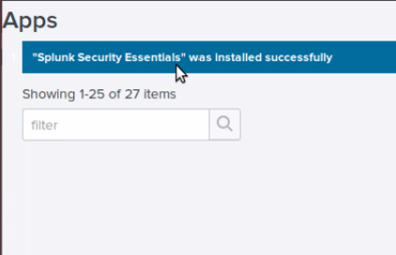
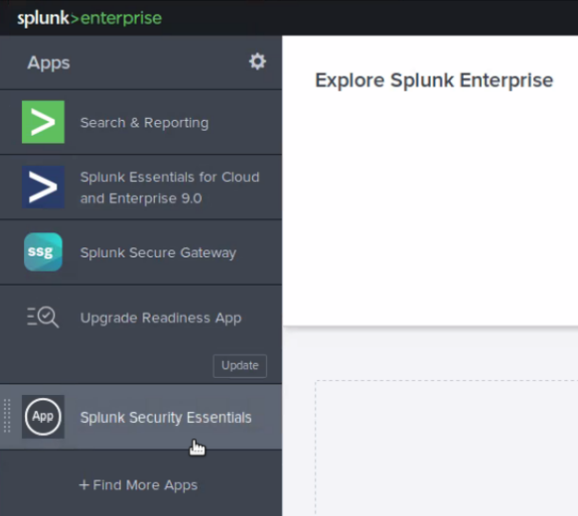
Splunk Security Essentials
SSE was installed as an add-on app in Splunk

Slide 9
Logs Analyzed
Windows Logs
Apache Logs
1
2
Windows server contains intellectual property of VSI's next-generation virtual-reality programs.
Logs provide by VSI
Windows Server Logs
Windows Server Attack L ogs
Apache server is used for VSI's main public-facing website, vsi-company.com.
Logs provide by VSI
Apache Logs
Apache Attack Logs

Slide 10
Windows Logs
10

Slide 11
Reports—Windows
Designed the following reports:
Report Name | Report Description
Severity Level Count & Percentage | A report that displays the severity levels, and the count and percentage of each.
Signature IDs | A report with a table of signatures and associated signature IDs.
Success Comparison Report | A report that provides a comparison between the success and failure of Windows activities.

Slide 12
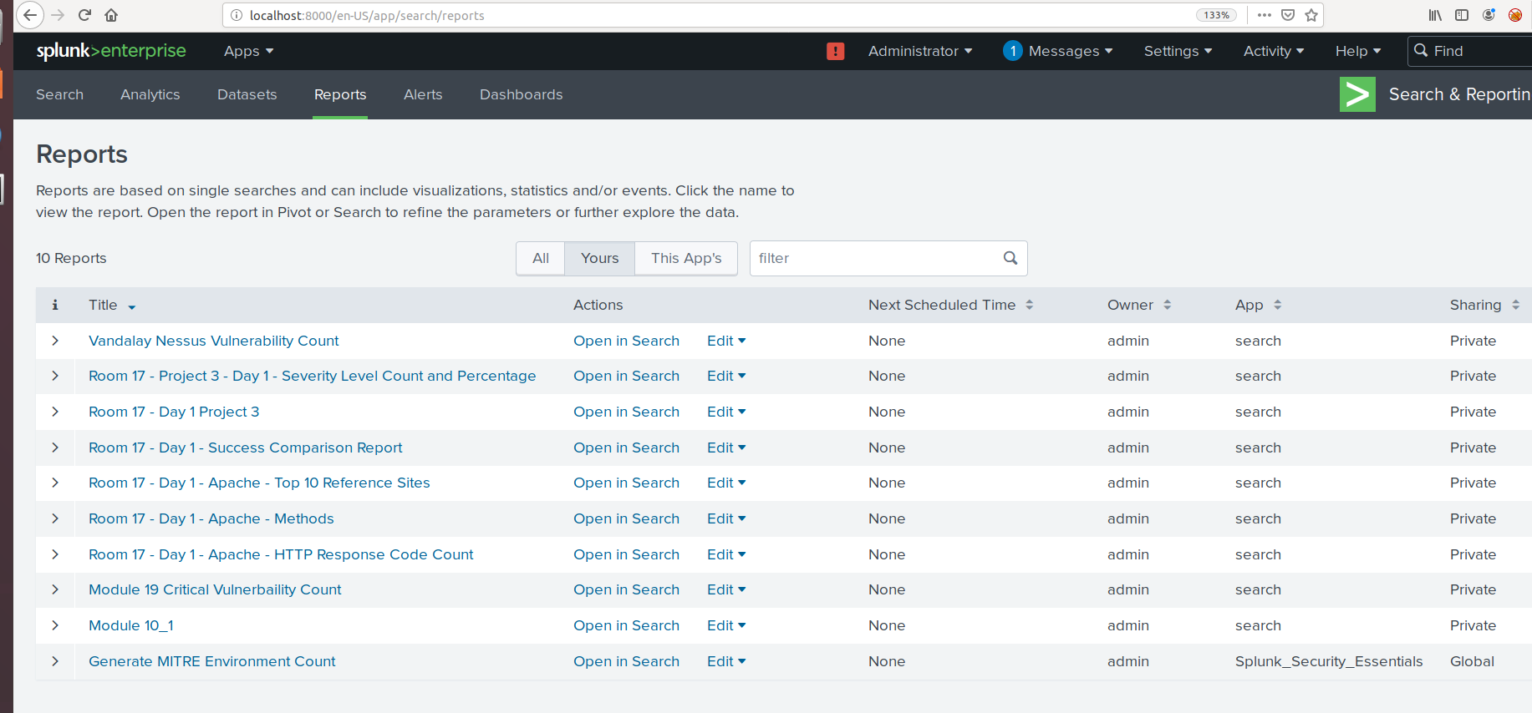
Reports

Slide 13
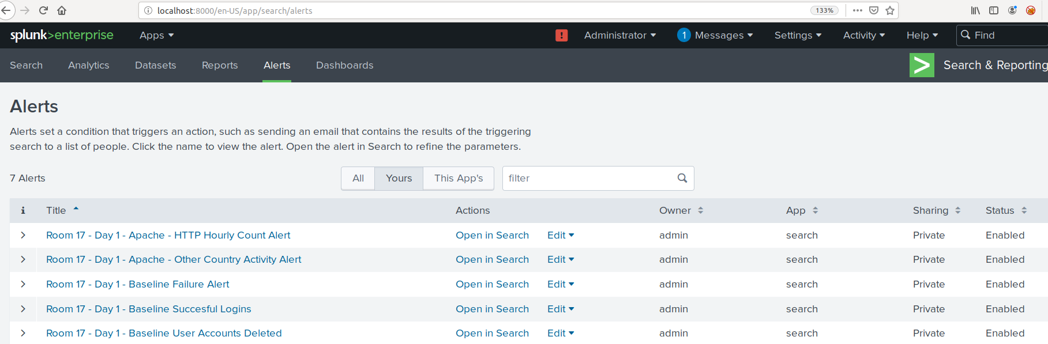
Alerts

Slide 14
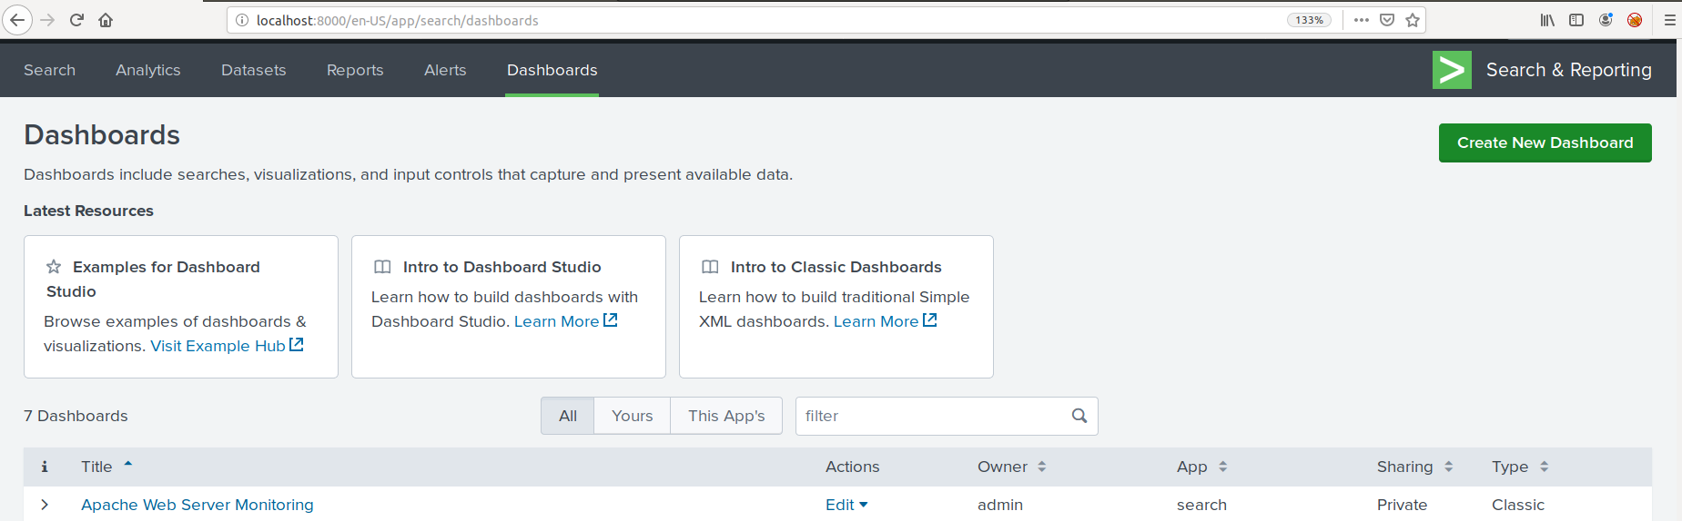
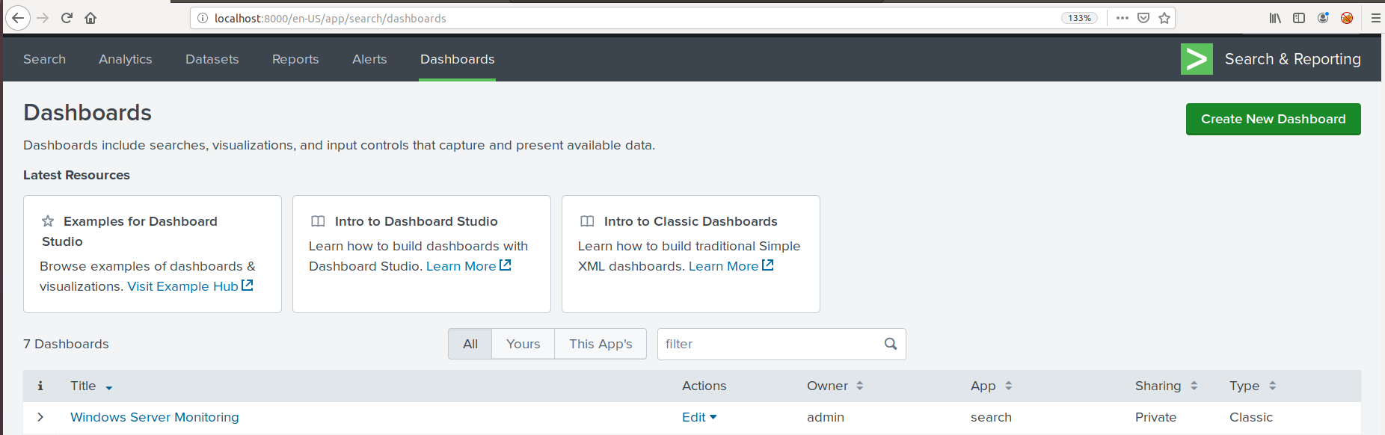
Dashboards

Slide 15
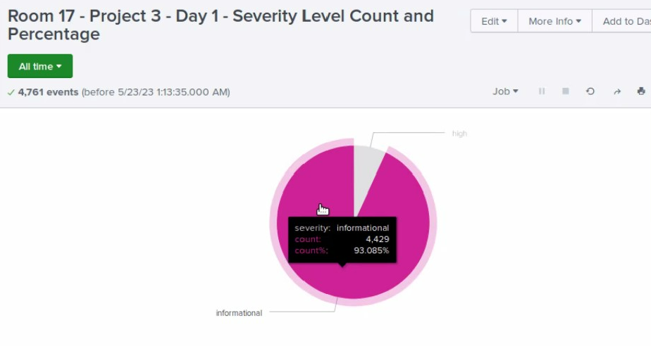
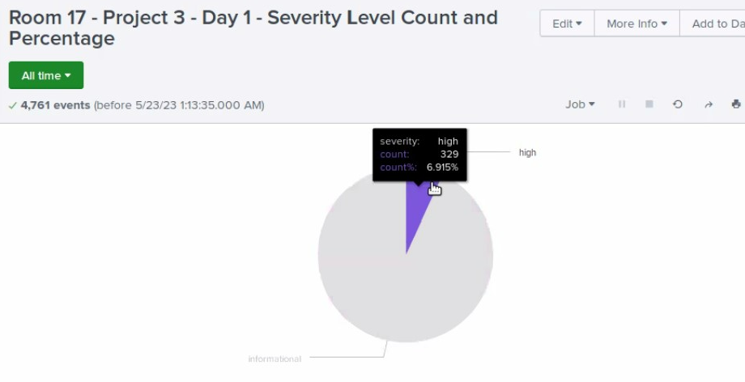
Reports - Windows
Severity Level Count & Percentage Report

Slide 16
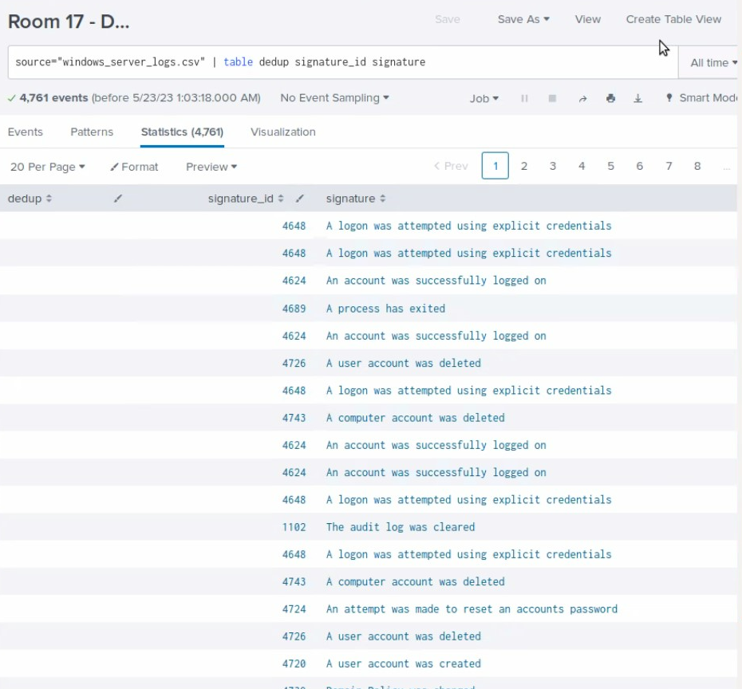
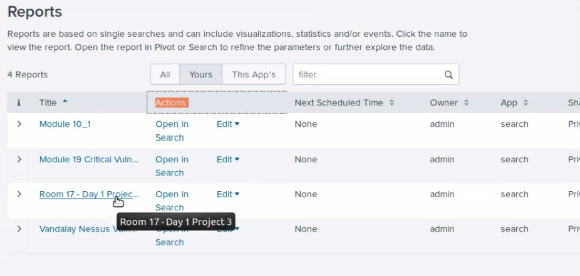
Reports - Windows
Signature IDs Report

Slide 17
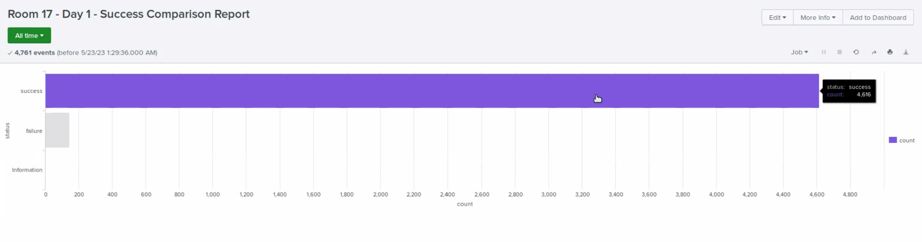
Reports - Windows
Success Comparison Report

Slide 18
Alerts - Windows
Designed the following alerts:
Alert Name | Alert Description | Alert Baseline | Alert Threshold
Baseline Failure Alert | Alert is triggered when the threshold exceeds baseline count for specified baseline windows activity. | Based off of Normal Windows activity. | 142
JUSTIFICATION: Determine a baseline and threshold for the hourly level of failed Windows activity.

Slide 19
Alerts - Windows
Designed the following alerts:
Alert Name | Alert Description | Alert Baseline | Alert Threshold
Baseline Successful Logins | Alert is triggered when the threshold for successful account login has been breached | Based off of Normal successful logins. | 323
JUSTIFICATION: Determine a baseline and threshold for the hourly count of the signature “an account was successfully logged on.”

Slide 20
Alerts - Windows
Designed the following alerts:
Alert Name | Alert Description | Alert Baseline | Alert Threshold
Room 17 – Day 1 – Baseline User Accounts Deleted | Alert is triggered when the threshold for user account deletion has been breached | Based off of Normal deleted user account signature. | 318
JUSTIFICATION: Determine a baseline and threshold for the hourly count of the signature “a user account was deleted.”

Slide 21
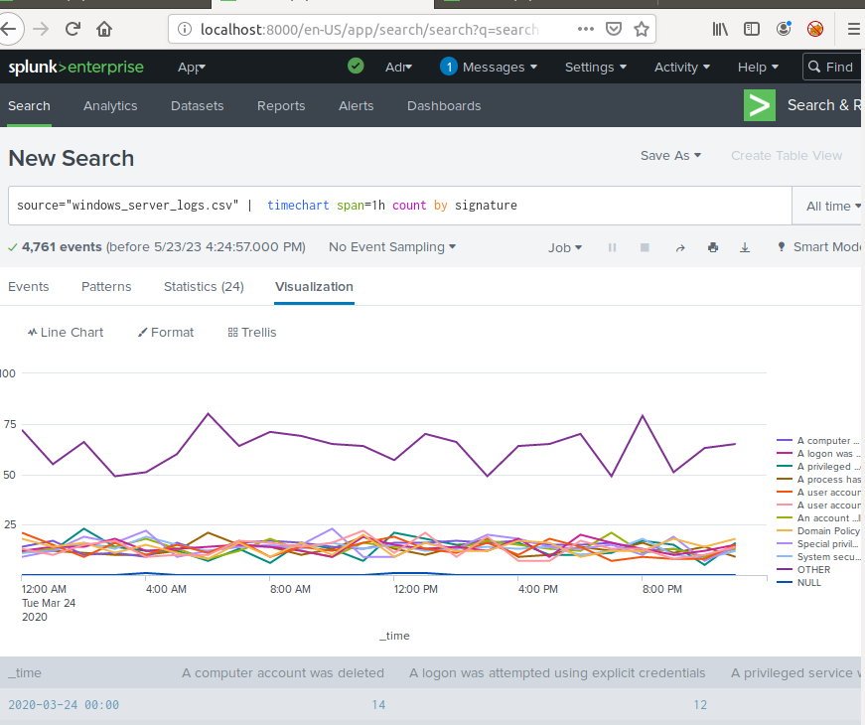
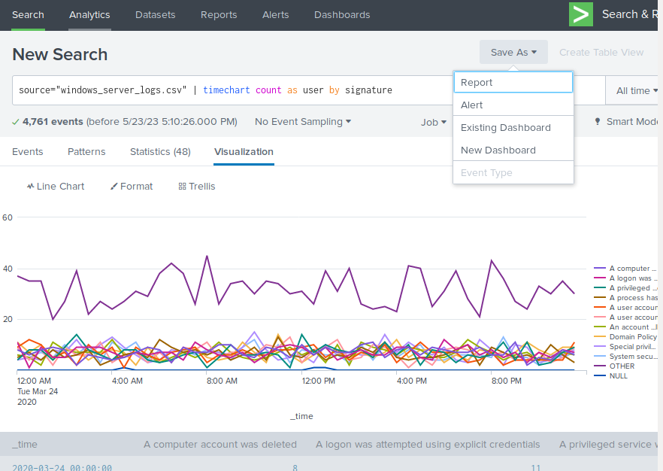
Dashboards - Windows

Slide 22
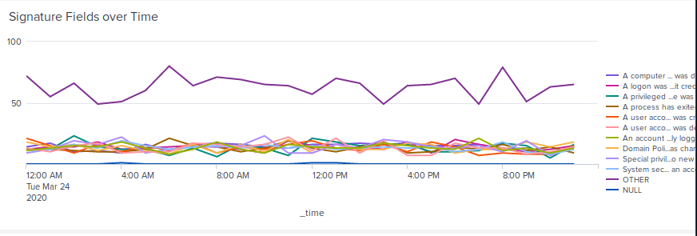
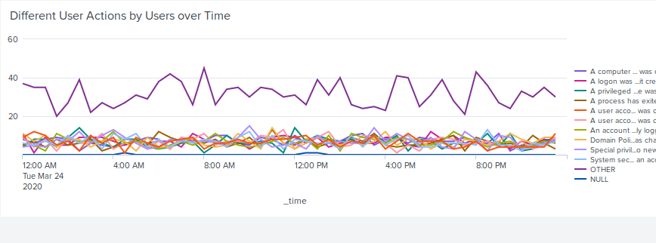
Dashboards - Windows

Slide 23
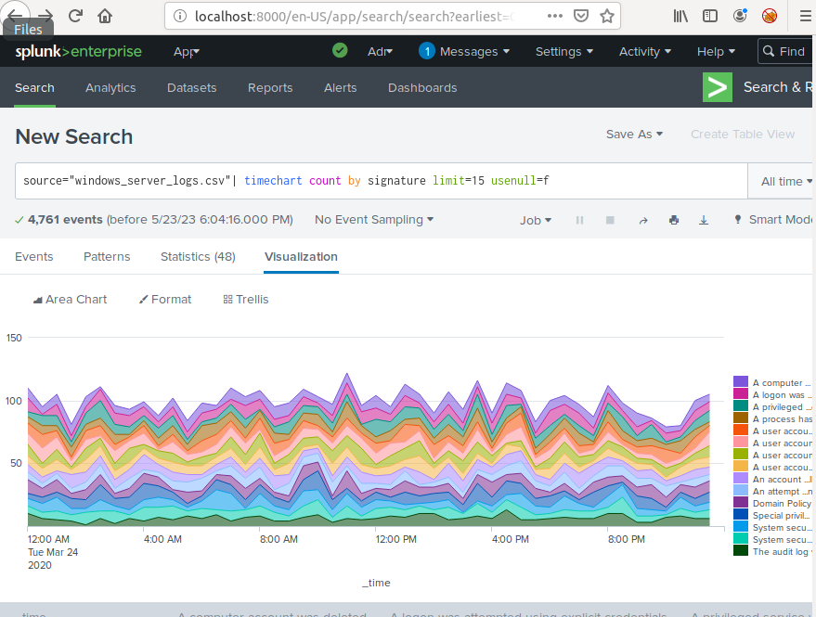
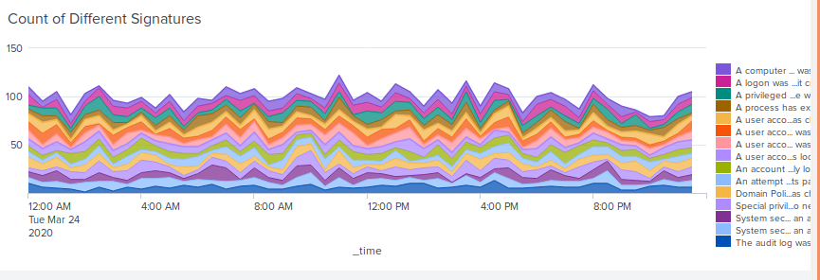
Dashboards - Windows

Slide 24
Apache Logs
24

Slide 25
Reports - Apache
Designed the following reports:
Report Name | Report Description
Top 10 Reference Sites Methods HTTP Response Code Count | A report that shows the top 10 domains that refer to VSI’s website. A report that shows a table of the different HTTP methods (GET, POST, HEAD, etc.). A report that shows the count of each HTTP response code.

Slide 26
Reports - Apache
Top 10 Reference Sites

Slide 27
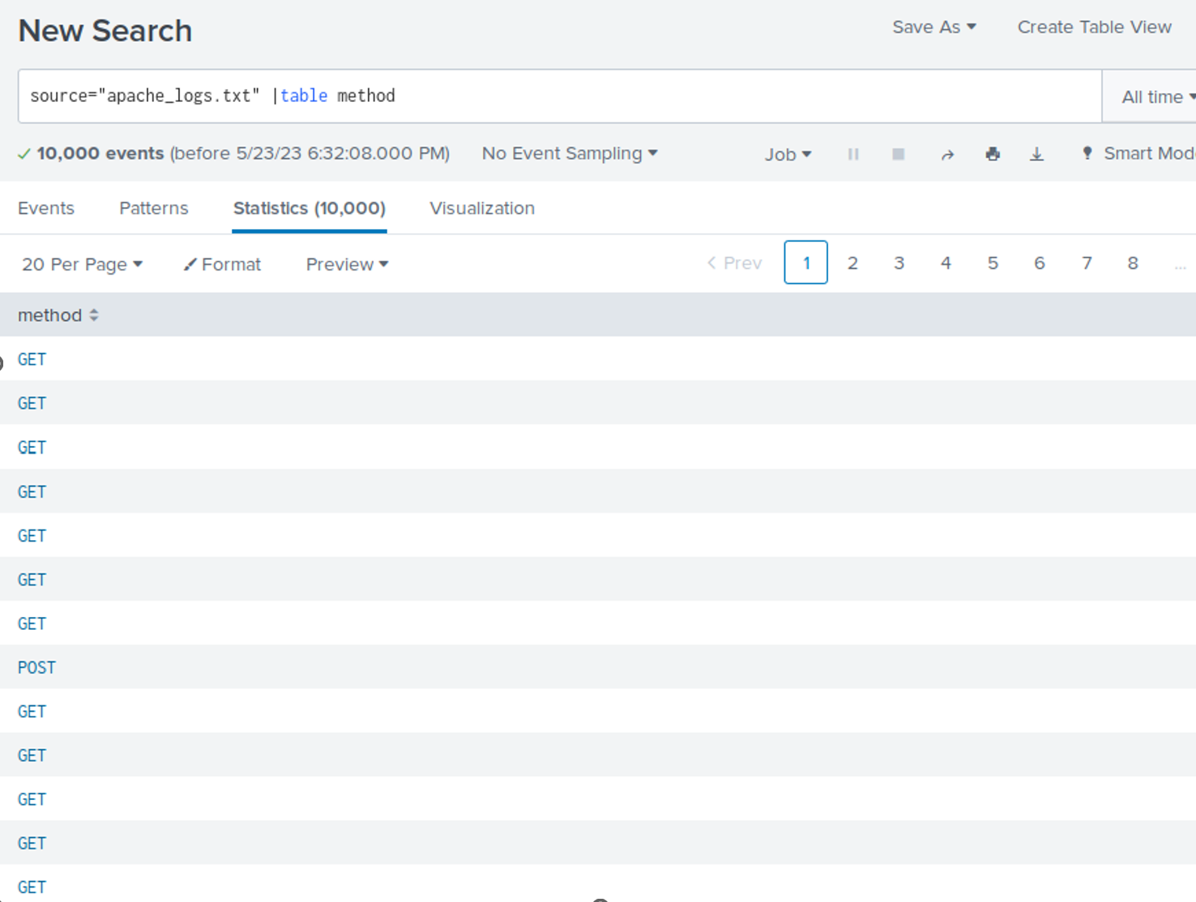
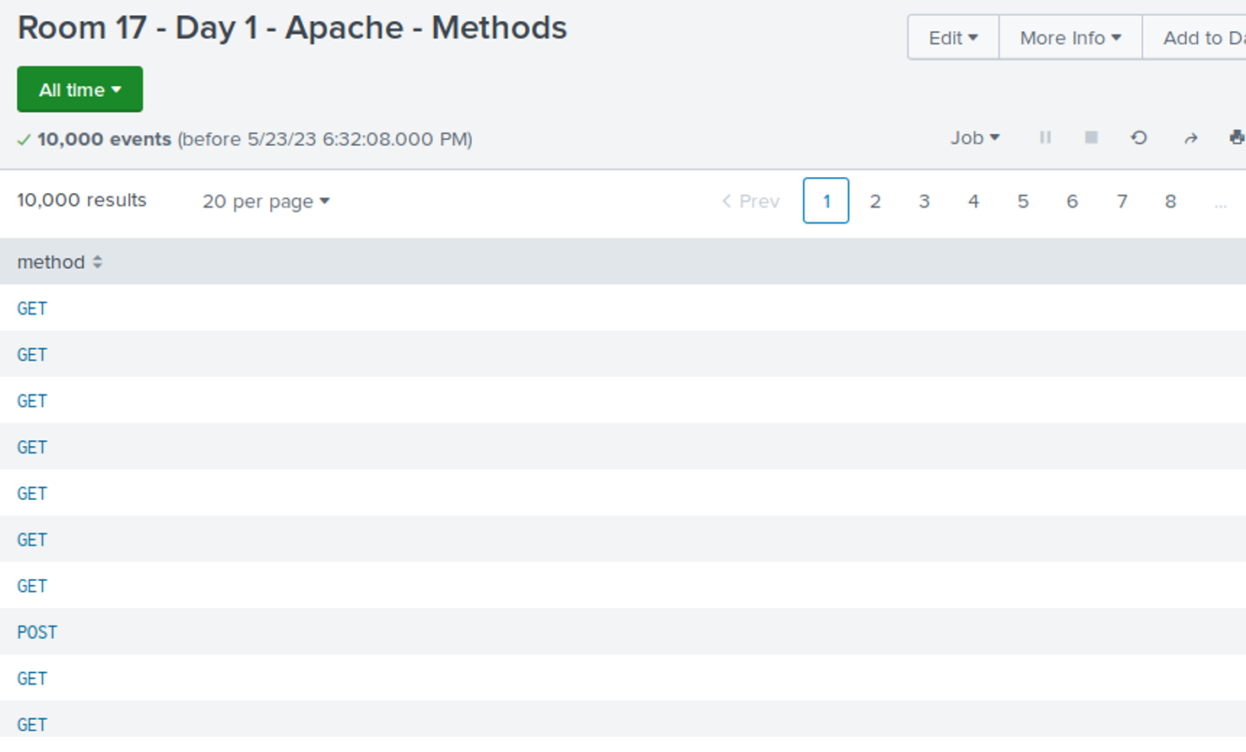
Reports - Apache
Report that shows a table of the different HTTP methods

Slide 28
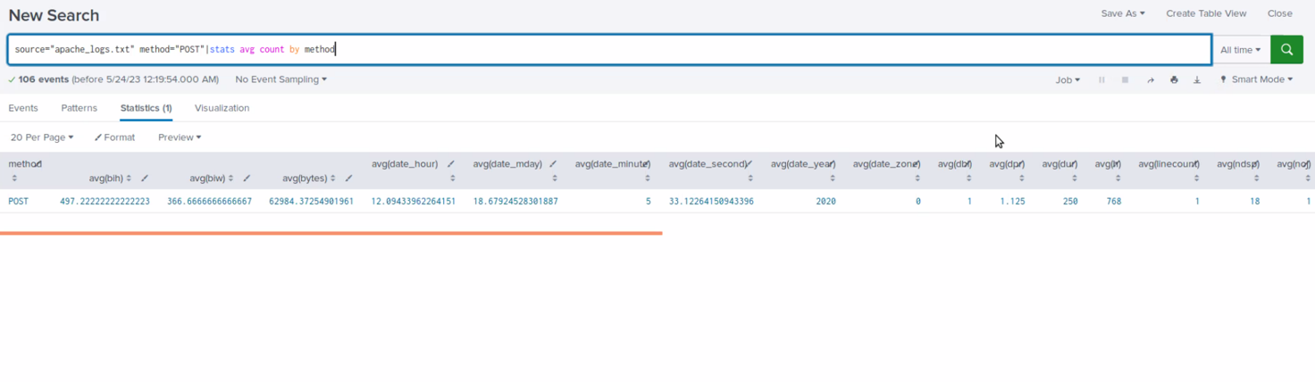
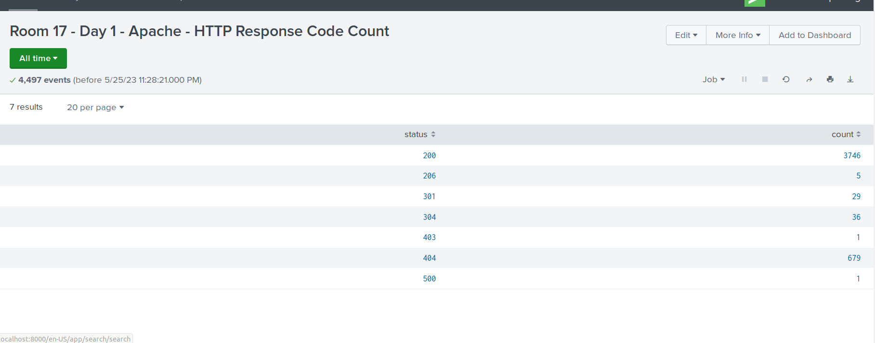
Reports - Apache
Report that shows the count of each HTTP response code.

Slide 29
Alerts - Apache
Designed the following alerts:
Alert Name | Alert Description | Alert Baseline | Alert Threshold
Other Country Activity | Alert is triggered when the threshold for activity from any country besides the United States breaches threshold | Based off of Normal activity from countries outside of the US. | 6148
JUSTIFICATION: Determine a baseline and threshold for hourly activity from any country besides the United States

Slide 30
Alerts - Apache
Designed the following alerts:
Alert Name | Alert Description | Alert Baseline | Alert Threshold
HTTP Hourly Count Alert | Alert is triggered when the threshold for hourly count of the HTTP POST method | Based off of Normal web POST activity that is creating or updating web resources. | 12
JUSTIFICATION: Determine an appropriate baseline and threshold for the hourly count of the HTTP POST method.

Slide 31
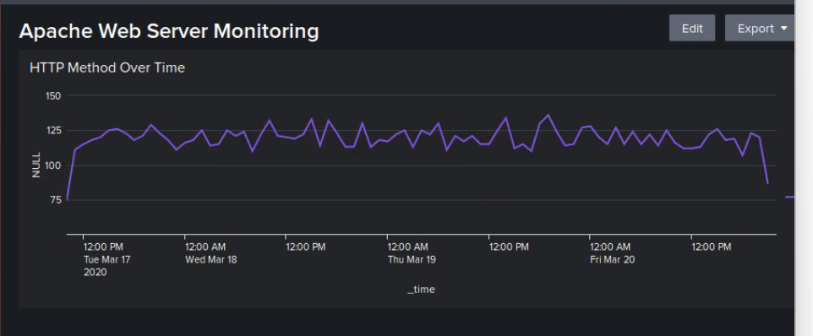
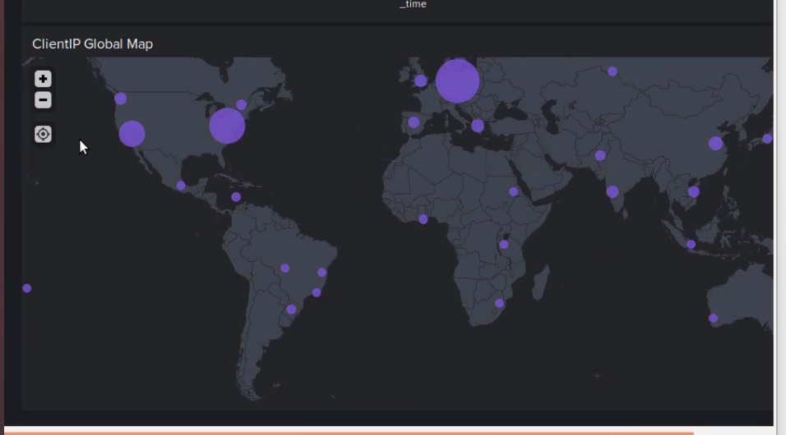
Dashboards - Apache

Slide 32
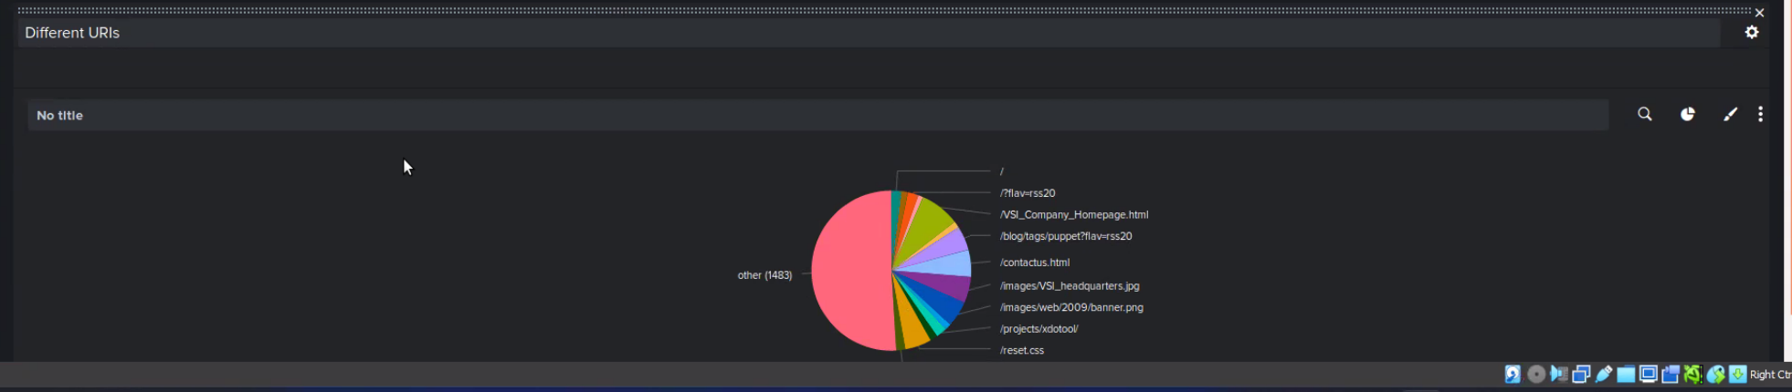
Dashboards - Apache

Slide 33
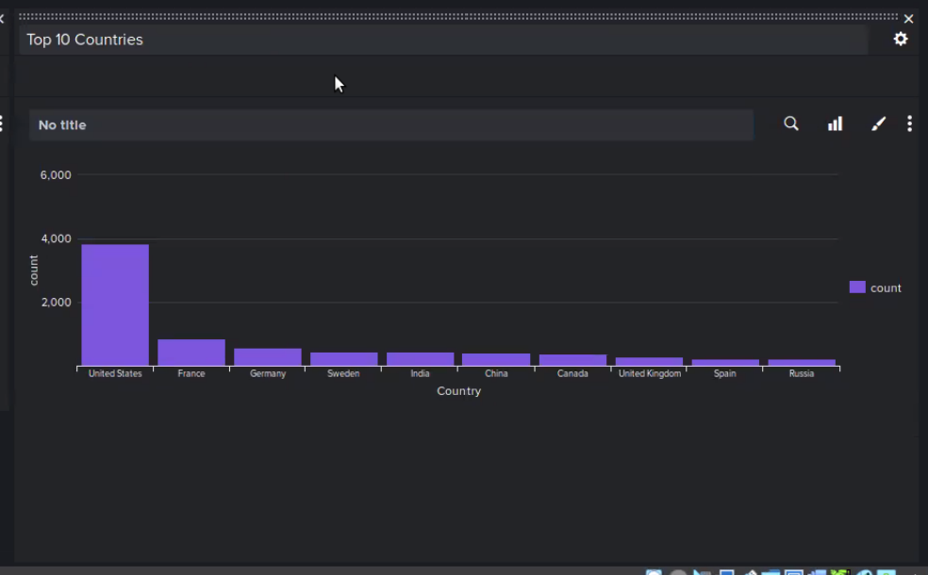
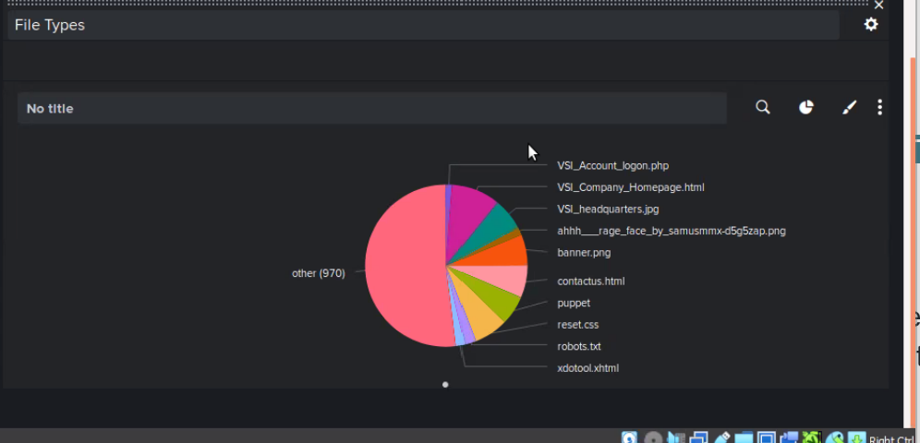
Dashboards - Apache

Slide 34
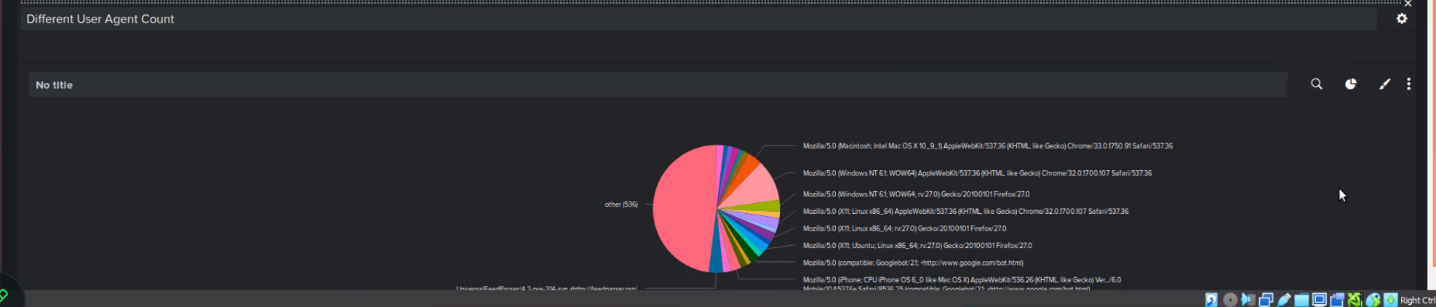
Dashboards - Apache

Slide 35
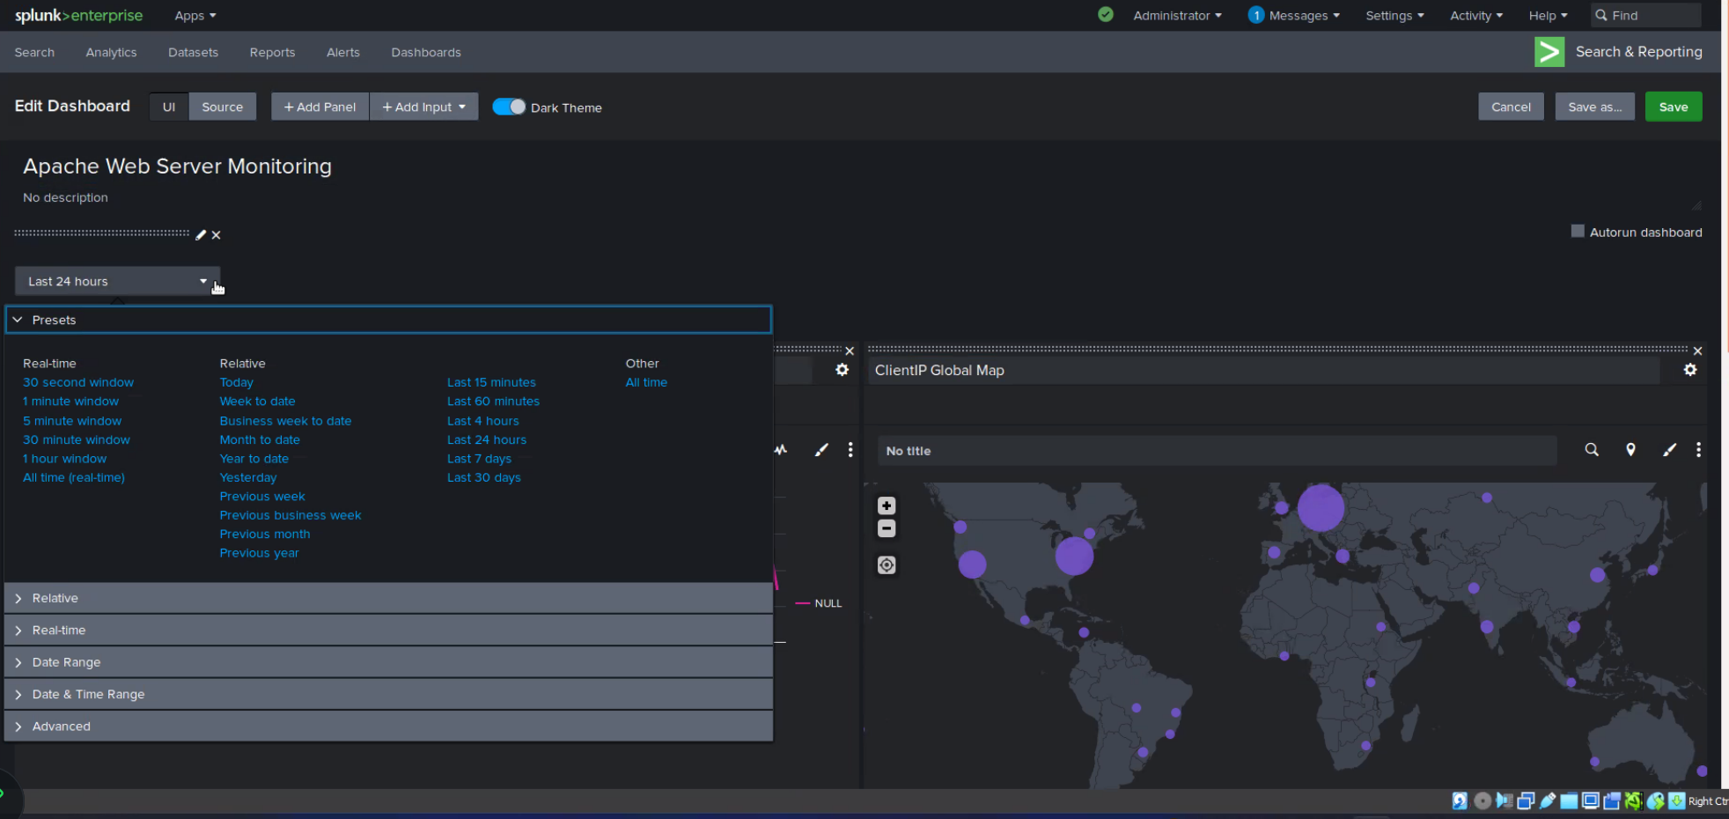
Dashboards - Apache

Slide 36
Attack Analysis
36

Slide 37
Attack Summary - Windows
Summarize your findings from your reports when analyzing the attack logs.
Yes, ‘A user account was locked out’ spiked at 3/25/20 at 2am and ‘An attempt was made to reset and accounts password’ then spiked on the same morning at 9am
‘An attempt was made to reset and accounts password’ was the highest, followed–up by ‘A user account was locked out’‘An attempt was made to reset and accounts password’ started 3/25 around 8a.m and stopped around 11am.
‘A user account was locked out’ started 3/25 around 12am and stopped around 3am.‘An attempt was made to reset and accounts password’=1258
‘A user account was locked out’= 896

Slide 38
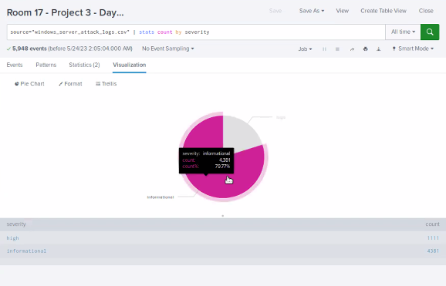
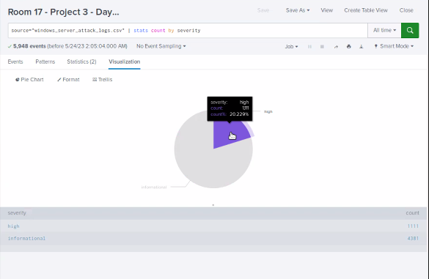
Screenshots of Attack Logs

Slide 39
Attack Summary - Apache
Summarize your findings from your reports when analyzing the attack logs.
Posts increased from 1% to 29%
To send data to the web server to update or create a resource.The was a slight drop in referral traffic from http://www.semicomplete.com (before: 51%, after 49%) and slight increase in traffic from http://semicomplet.com (before: 34%, after:37)
The most significant change was in 404 (page not found) error codes returned, from 2% to %15.

Slide 40
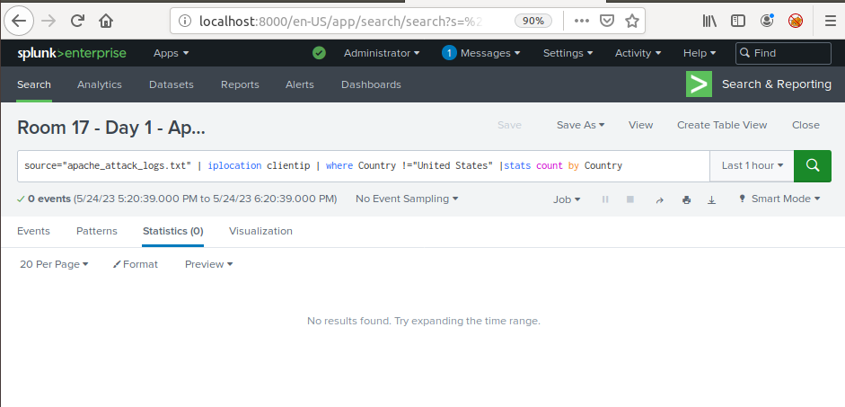
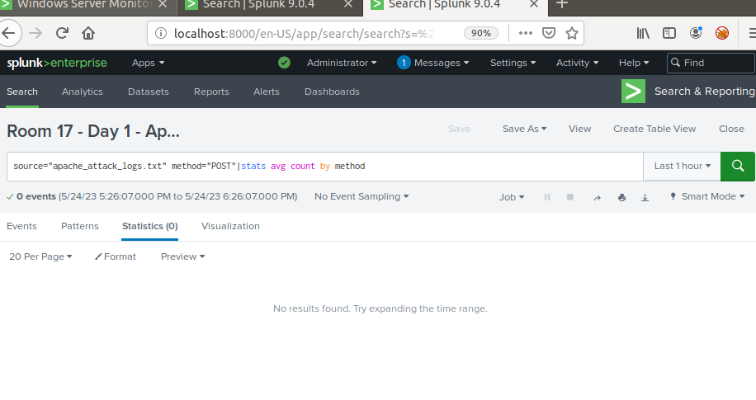
Screenshots of Attack Logs
[Optional: Place images that illustrate attack findings here.]

Slide 41
Summary and Future Mitigations
41

Slide 42
Summary
What were your overall findings from the attack that took place?
Two new locations- Hong-Kong, and Shanghai the attacks came in waves from the attack timings within 1am to 9am US EST. These attacks fits within the timings of the Time zone in those locations being in business hours.
To protect VSI from future attacks, what future mitigations would you recommend?
The focus of these attacks were on URI’s and web resources where there could've been a possibility to target a vulnerability in security alerts/thresholds. We would recommend creating alerts on the creation and/or deletion of files within the other resource directory.

